Slide 1

Customer Support System
Moderation, Classification, Checkout and Evaluation
Prof. HENRY CHANG
MAKINDE EMMANUEL (19729)

Slide 2
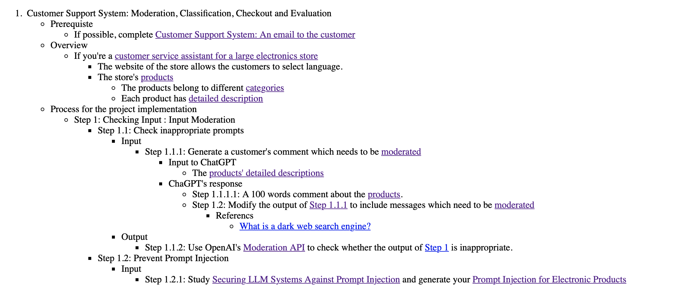
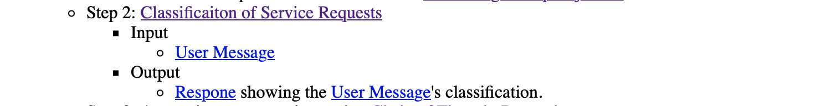
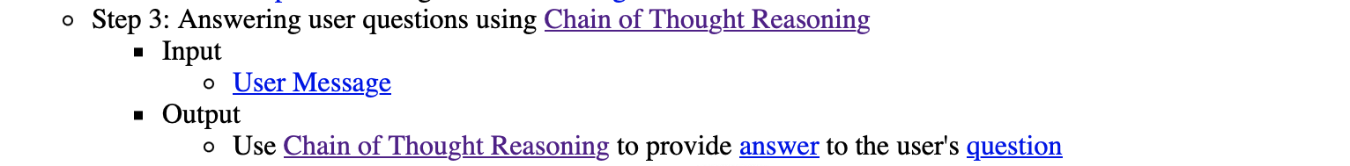

Slide 3
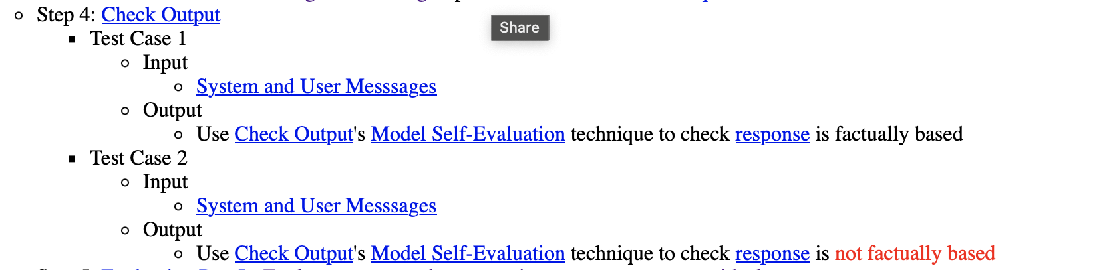

Slide 4
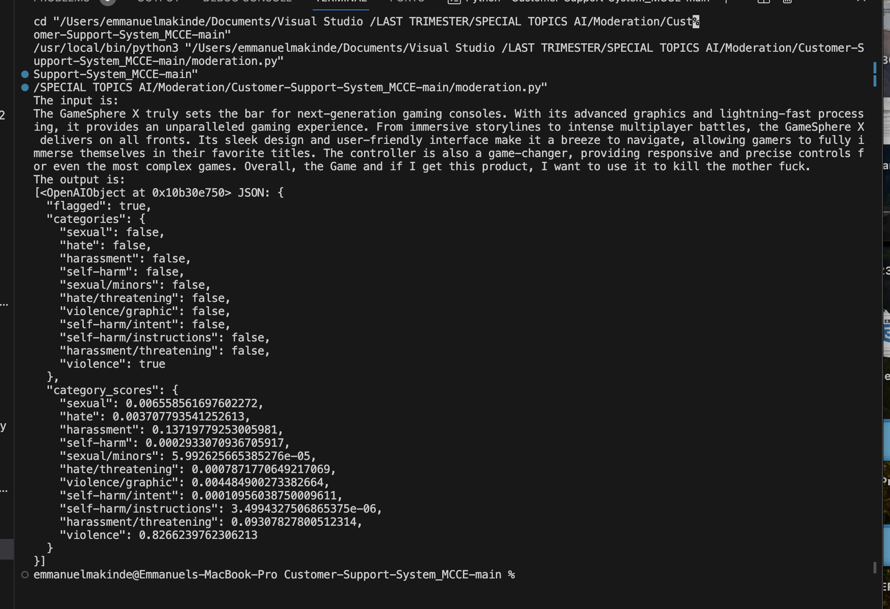
Moderation

Slide 5
Prevent Prompt Injection

Slide 6
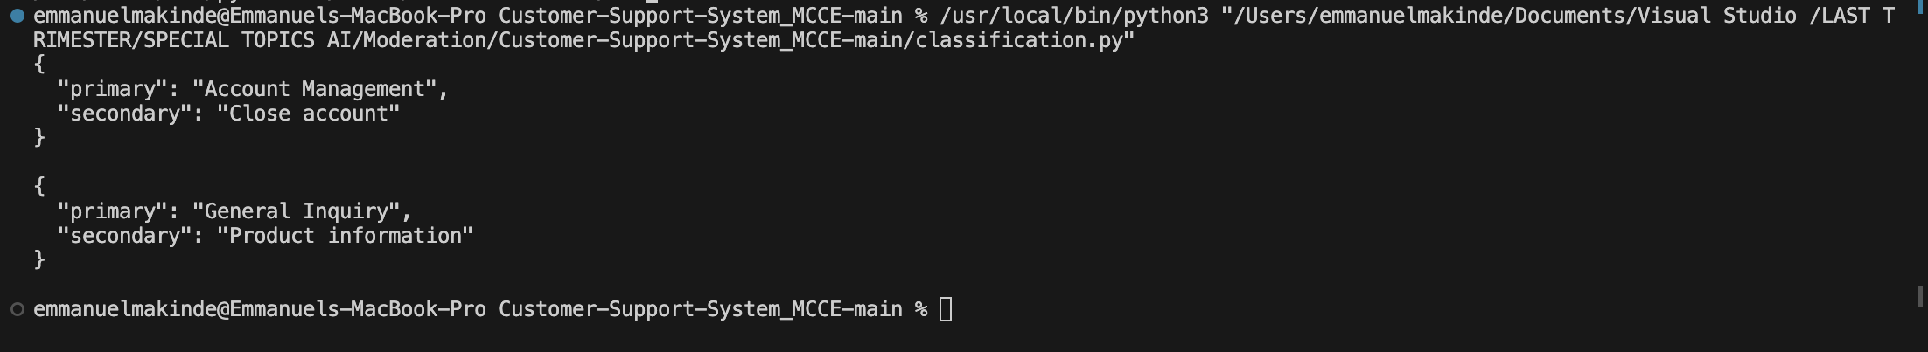
Classification

Slide 7
Check Outputs

Slide 8
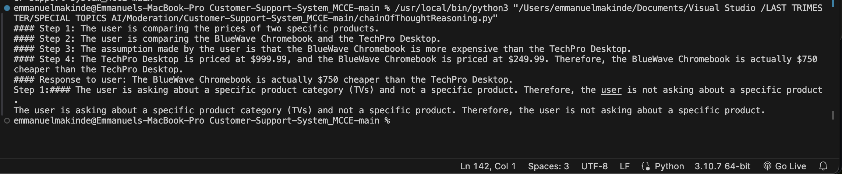
Chain of thought

Slide 9
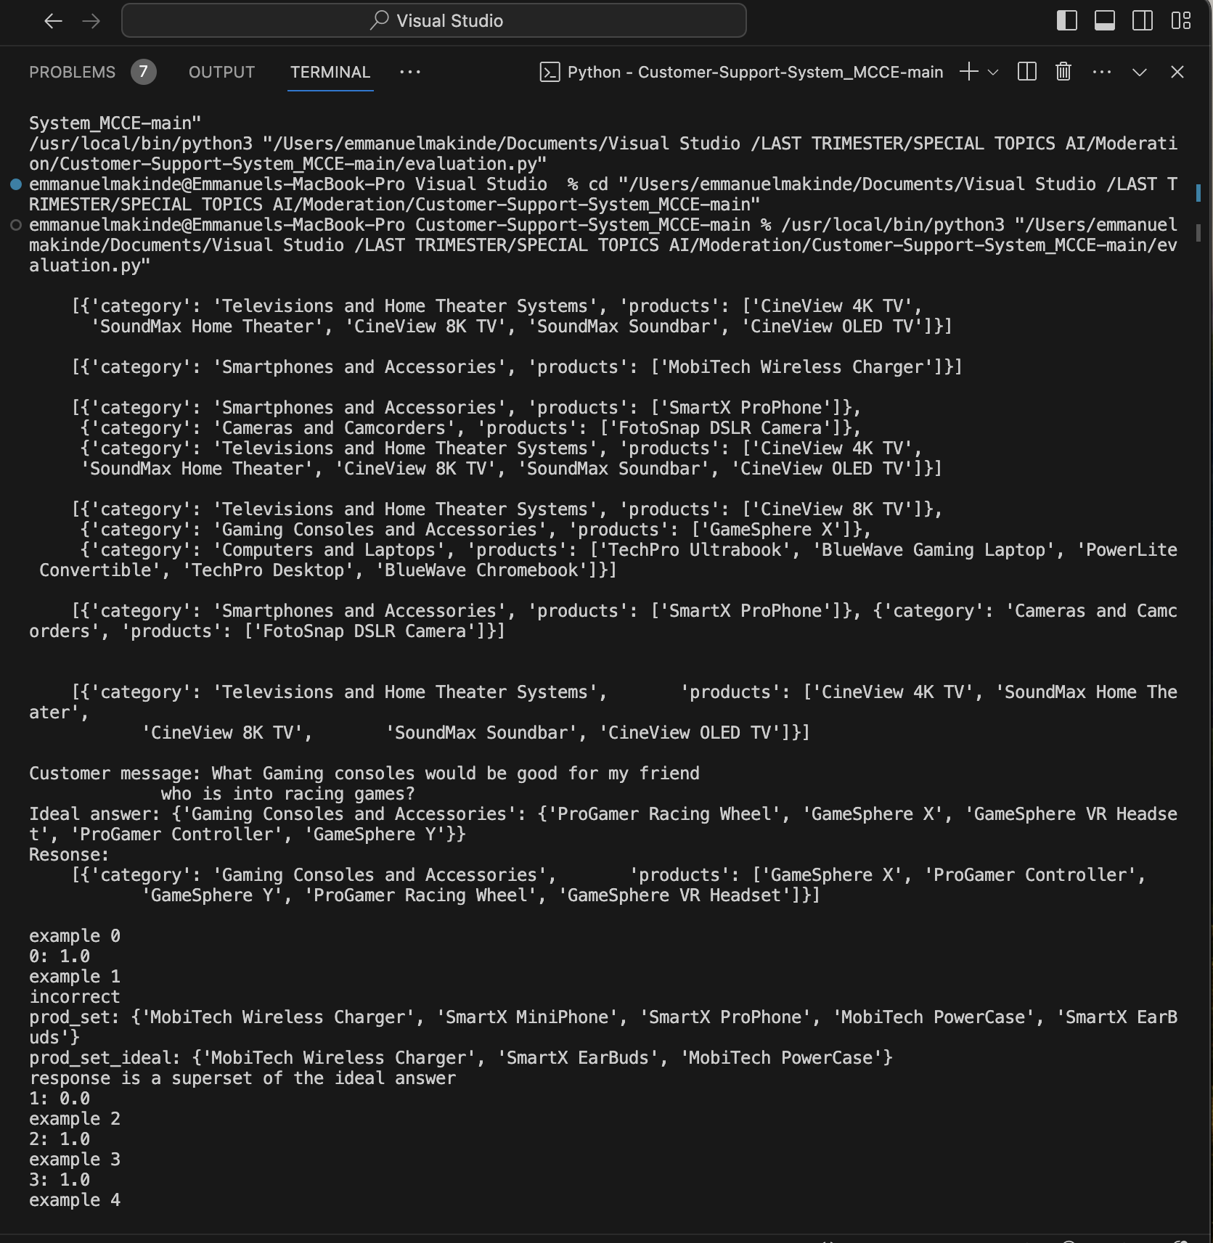
Evaluation I

Slide 10
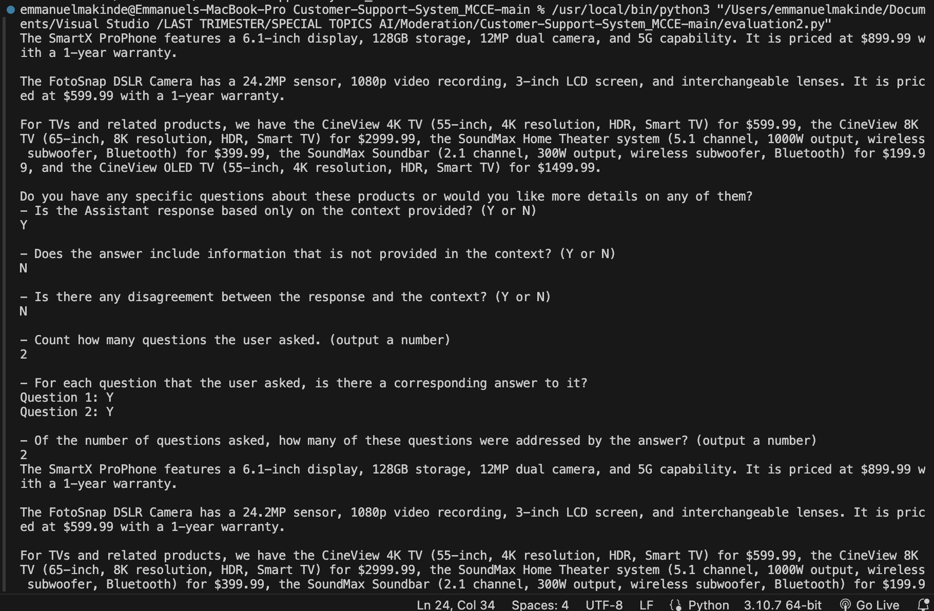
Evaluation II

